Slide 1



PROJECT
OLIST E - COMMERCE STORE ANALYSIS

Slide 2


GROUP - 1
1 . SANSKRITI VERMA
2 . DHIWAAKAR M
3 . ANKIT AJITSING CHANDEL
4 . TIRUNAVALLI SAI AKASH
5 . MOHAMMAD AZIM
6 . RAJAT N. SHARMA

Slide 3


vOther methods like voucher, debit card, and undefined have significantly lower transaction values.
This tells us that customers strongly prefer credit cards for online purchases."
E-Commerce Dashboard Overview
Today, we are going to Explain our E-Commerce Dashboard, which provides a comprehensive overview of key metrics related to customer payments, order behavior, delivery times, and product performance.
Let’s begin by exploring the insights one panel at a time."
So in this first we have done the cleaning part and checked wheather errors and null are removed before creating KPI’s
and then we created KPI’s and for each KPI we have done some calculations that we need to add .
📊
1. Payment Summary by Type (Top Left):
"This chart highlights the total and average payment values by different payment types.
As we can see, credit cards dominate with a total payment value of 13 million, followed by boleto at 3 million.
Other methods like voucher, debit card, and undefined have significantly lower transaction values.
This tells us that customers strongly prefer credit cards for online purchases."

Slide 4


📈 2. Order & Review Counts by Payment Type (Top Center):
"This bar chart shows the count of orders and review scores segmented by payment type.
Again, credit cards lead with nearly 99K orders, indicating not only high value but high volume as well.
The number of reviews aligns closely with the order volume, reinforcing that credit card users are the most active customers."
🧾 3. Filters (Top Right):
"To the right, we have slicers for payment type and order status, allowing us to filter the data dynamically.
This enables more granular analysis, such as focusing only on delivered or approved orders."
💳 4. São Paulo Order Analysis (Bottom Left):
"This section focuses on customers from São Paulo (SP).
The average order price is 110, while the average payment value is slightly higher at 138.
This suggests possible use of multiple payment installments or additional services like express delivery or tips."

Slide 5


🚚 5. Delivery Time vs. Review Score (Bottom Center):
"Here we analyze the relationship between delivery time and review score:
The average delivery time is 12.5 days, while the average review score is 4.09 out of 5.
This indicates that even with longer delivery times, customers are fairly satisfied — though there's room to improve delivery speed."
🐾 6. Delivery Time by Product Category (Bottom Right):
"This chart breaks down average delivery time by product category, and currently displays data for pet_shop, which also has a delivery time of 12.5 days.
We can use filters to explore other categories and identify where delays are more prominent."

Slide 6

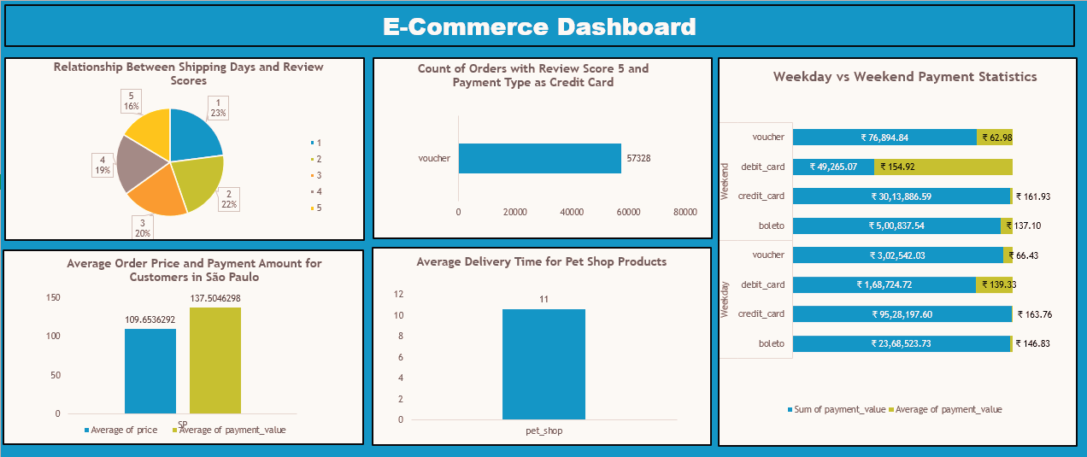
EXCEL DASHBOARD

Slide 7
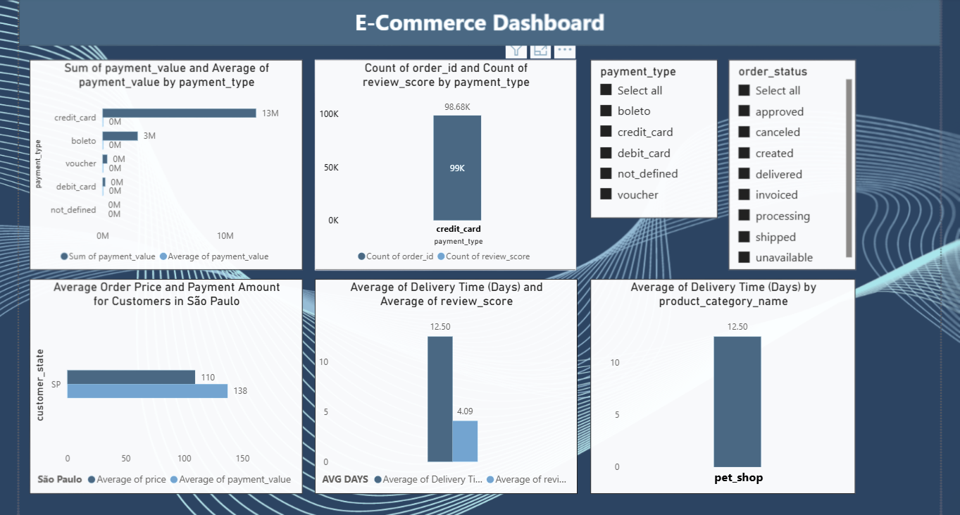
POWERBI DASHBOARD

Slide 8
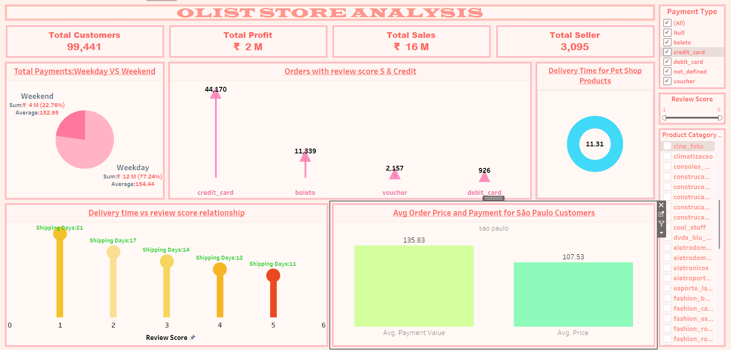
TABLEAU DASHBOARD

Slide 9
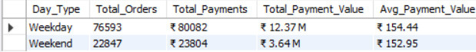
SQL QUERIES
- KPI 1: Weekday vs Weekend Payment Statistics
SELECT
o.order_id,
o.order_purchase_timestamp,
p.payment_value
FROM
orders o
JOIN
order_payments p ON o.order_id = p.order_id
WHERE
o.order_purchase_timestamp IS NOT NULL;
SELECT
CASE
WHEN DAYOFWEEK(order_purchase_timestamp) IN (1, 7) THEN 'Weekend'
ELSE 'Weekday'
END AS Day_Type,
COUNT(DISTINCT o.order_id) AS Total_Orders,
CONCAT('₹ ', COUNT(*)) AS Total_Payments,
CONCAT('₹ ', ROUND(SUM(p.payment_value)/1000000, 2), ' M') AS Total_Payment_Value,
CONCAT('₹ ', ROUND(AVG(p.payment_value), 2)) AS Avg_Payment_Value
FROM
orders o
JOIN
order_payments p ON o.order_id = p.order_id
WHERE
o.order_purchase_timestamp IS NOT NULL
GROUP BY
Day_Type;

Slide 10
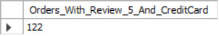
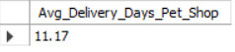
KPI 2: Count of Orders with Review Score 5 and Payment Type as Credit Card
SELECT
COUNT(DISTINCT o.order_id) AS Orders_With_Review_5_And_CreditCard
FROM
orders o
JOIN
order_review r ON o.order_id = r.order_id
JOIN
order_payments p ON o.order_id = p.order_id
WHERE
r.review_score = 5
AND LOWER(p.payment_type) = 'credit_card';
KPI 3: Average Delivery Time for Pet Shop Products
SELECT
ROUND(AVG(DATEDIFF(o.order_delivered_customer_date, o.order_purchase_timestamp)), 2) AS Avg_Delivery_Days_Pet_Shop
FROM
orders o
JOIN
order_items oi ON o.order_id = oi.order_id
JOIN
products p ON oi.product_id = p.product_id
WHERE
p.product_category_name = 'pet_shop'
AND o.order_delivered_customer_date IS NOT NULL
AND o.order_purchase_timestamp IS NOT NULL;

Slide 11
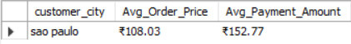
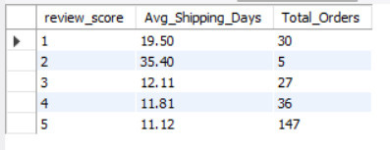
KPI 4: Average Order Price and Payment Amount for Customers in São Paulo
SELECT
c.customer_city,
CONCAT('₹', ROUND(AVG(oi.price), 2)) AS Avg_Order_Price,
CONCAT('₹', ROUND(AVG(p.payment_value), 2)) AS Avg_Payment_Amount
FROM
customers c
JOIN
orders o ON c.customer_id = o.customer_id
JOIN
order_items oi ON o.order_id = oi.order_id
JOIN
order_payments p ON o.order_id = p.order_id
WHERE
c.customer_city = 'sao paulo'
GROUP BY
c.customer_city;
KPI 5: Relationship Between Shipping Days and Review Scores
SELECT
r.review_score,
ROUND(AVG(DATEDIFF(o.order_delivered_customer_date, o.order_purchase_timestamp)), 2) AS Avg_Shipping_Days,
COUNT(*) AS Total_Orders
FROM
order_review r
JOIN
orders o ON r.order_id = o.order_id
WHERE
o.order_delivered_customer_date IS NOT NULL
AND o.order_purchase_timestamp IS NOT NULL
AND r.review_score BETWEEN 1 AND 5
GROUP BY
r.review_score
ORDER BY
r.review_score;

Slide 12

CONCLUSION :
"In summary:
Credit cards are the most used and valuable payment method.
Delivery speed is a key area for improvement, although customer satisfaction remains strong.
São Paulo remains a major contributor to sales with higher-than-average payments.
This dashboard provides a strong foundation for data-driven decisions in improving logistics, payment options, and customer satisfaction."

Slide 13

The detailed implementation roadmap will guide the company through the key milestones of market entry.

